Slide 1
Principles of Data Science
Li Niu

Slide 2




source domain
target domain
Source domain and target domain have different data distributions.

Slide 3
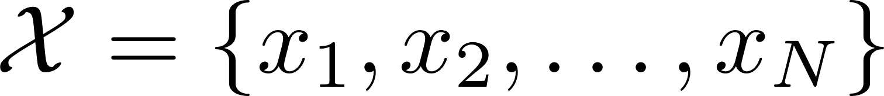

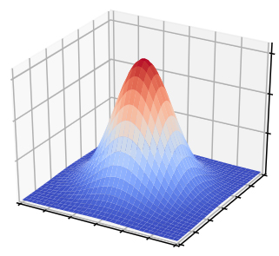
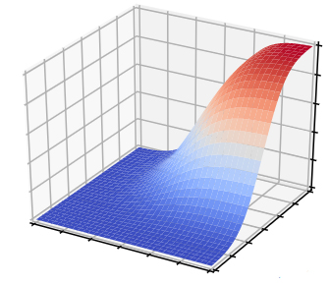
samples
data distribution

Slide 4
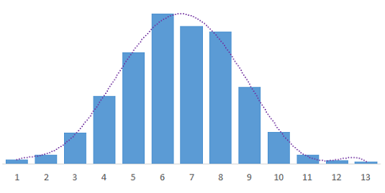
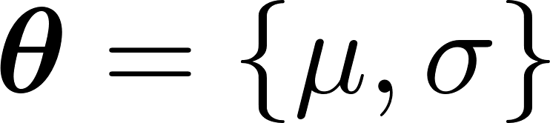
samples
distribution
11,8,5,5,4,5,8,8,10,9,5,3,10,6,2,8,7,4,7,9,4,8,6,9,5,6,7,6,9,7,7,7,6,7,9,6,5,3,8,8,5,8,6,7,7,8,6,5,4,6,10,6,9,8,7,4,6,6,7,9,8,10,3,7,8,8,8,7,6,9,7,3,6,9,6,5,4,5,6,9,5,7,5,6,5,9,6,8,6,8,5,6,12,8,4,8,6,4,7,13,5,10,7,7,5,7,1,9,2,4,8,7,5,8,5,4,3,7,4,6,11,3,4,10
normal distribution

Slide 5
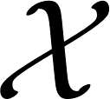
From sample to distribution
From distribution to sample
sample
distribution

Slide 6
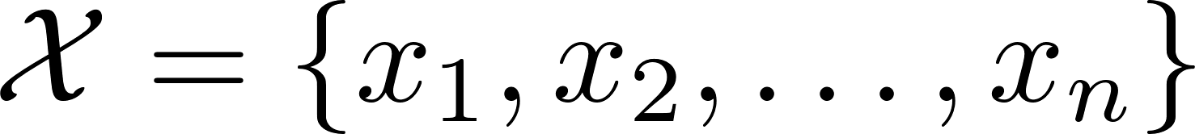
Data distribution
samples
Which type of distribution?
11,8,5,5,4,5,8,8,10,9,5,3,10,6,2,8,7,4,7,9,4,8,6,9,5,6,7,6,9,7,7,7,6,7,9,6,5,3,8,8,5,8,6,7,7,8,6,5,4,6,10,6,9,8,7,4,6,6,7,9,8,10,3,7,8,8,8,7,6,9,7,3,6,9,6,5,4,5,6,9,5,7,5,6,5,9,6,8,6,8,5,6,12,8,4,8,6,4,7,13,5,10,7,7,5,7,1,9,2,4,8,7,5,8,5,4,3,7,4,6,11,3,4,10
Parameter values?

Slide 7
Data distribution
Discrete distribution
Continuous distribution

Slide 8
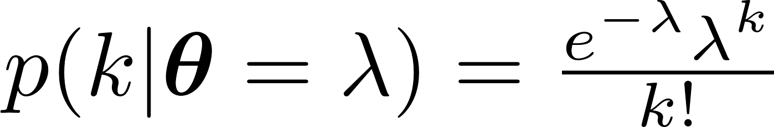
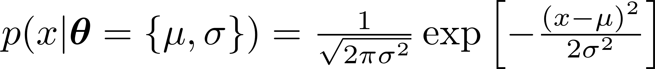
Data distribution
Discrete distribution
Binominal distribution: the number of successes in a binominal setting
Poisson distribution: the number of events that occur in a given interval of time
Continuous distribution
Gaussian distribution:

Slide 9
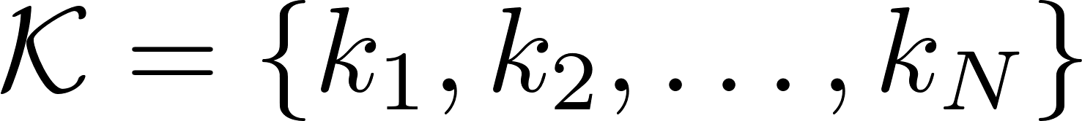
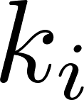
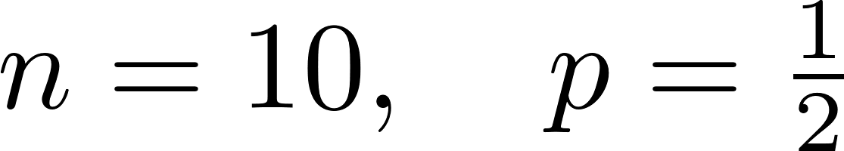
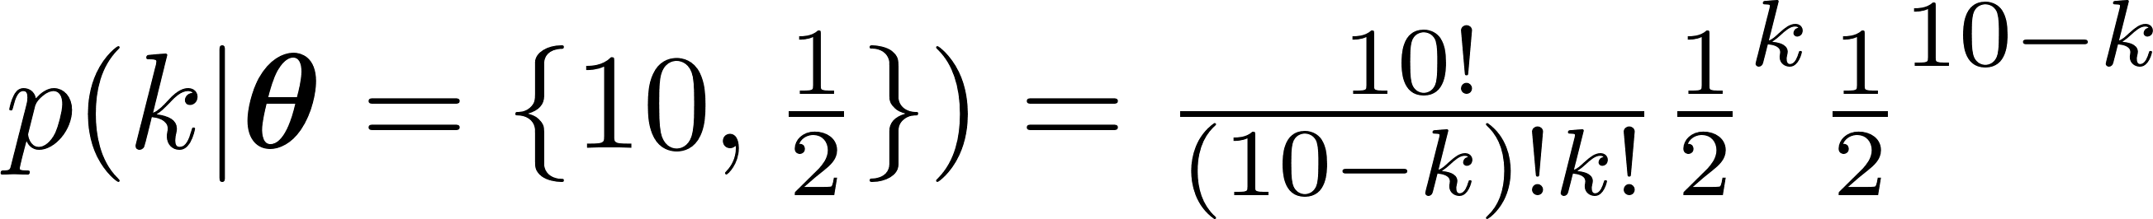
Data distribution
When we have prior information about the samples, for example,
Each is the number of “tail” occurrences when tossing a balanced coin 10 times.
Binominal distribution

Slide 10
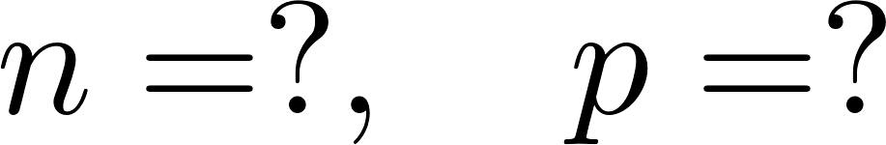


Data distribution
When we have prior information about the samples, for example,
Each is the number of “tail” occurrences when tossing a unbalanced coin multiple times.
Binominal distribution
We need to compute and

Slide 11
Data distribution
What if we know nothing about the following samples?

Slide 12
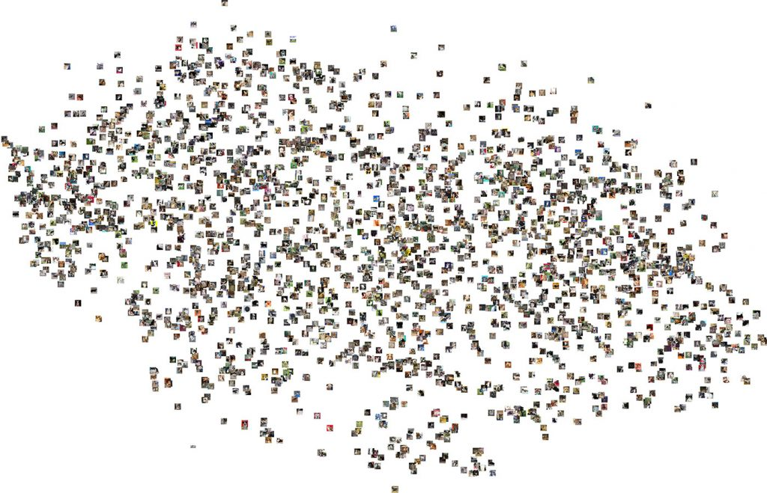
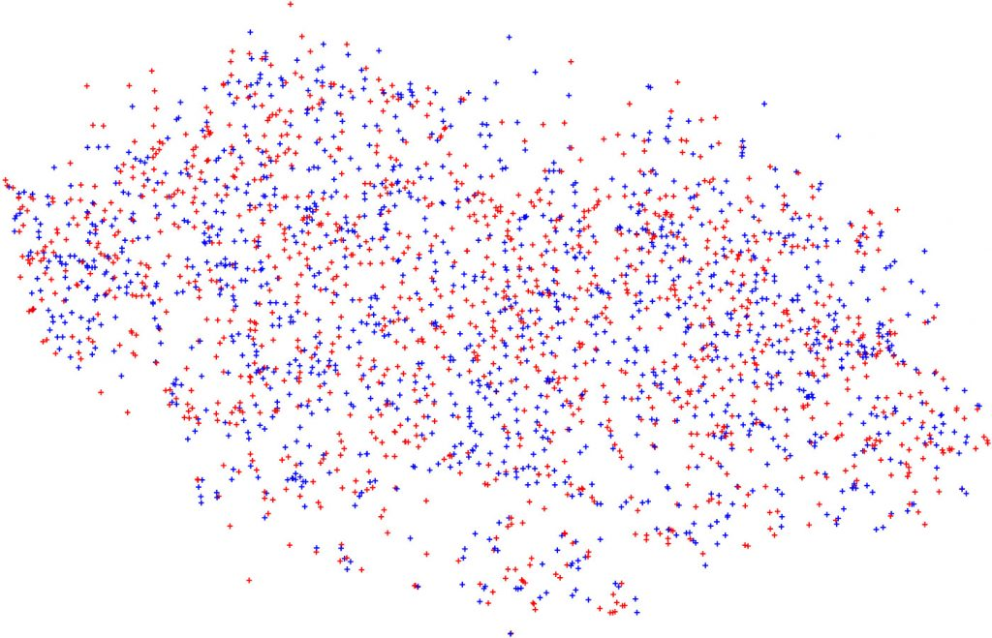
Data distribution
What if we know nothing about the following samples?
images
features

Slide 13
Data distribution
We need to make some assumptions, even if the assumption is inaccurate.
images
features

Slide 14
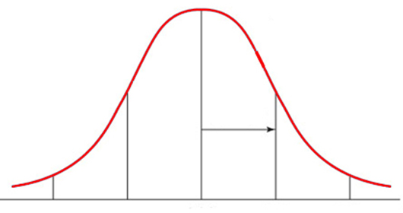


Data distribution assumption
Gaussian distribution is the most commonly used data distribution.
Given , we assume they follow Gaussian distribution
How to estimate and ?

Slide 15
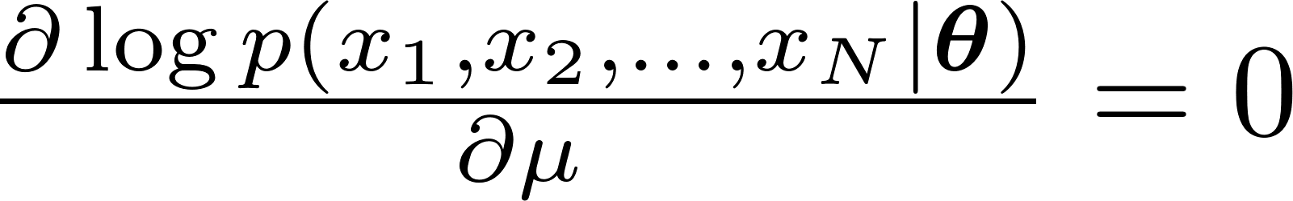
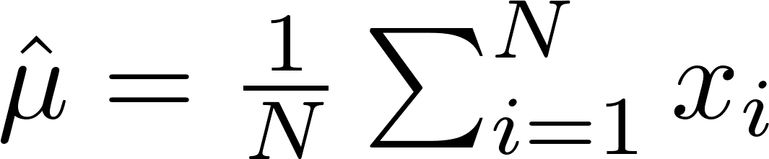
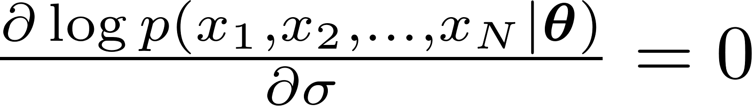
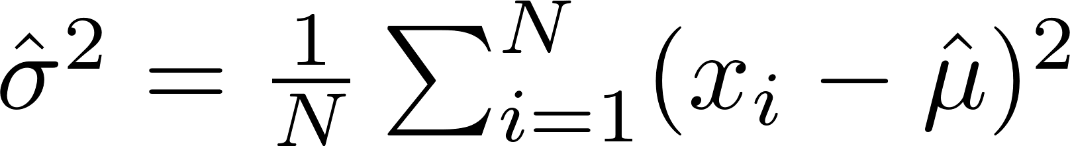
Maximum Likelihood Estimation (MLE)

Slide 16
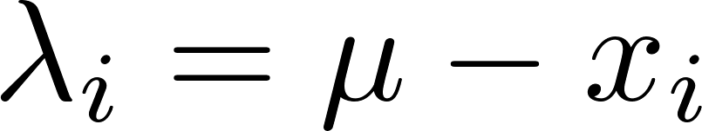
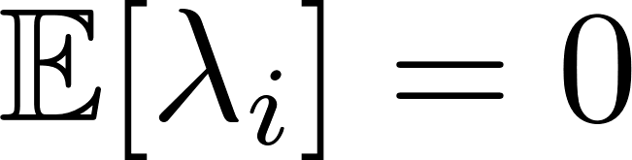
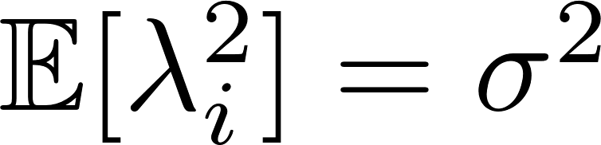
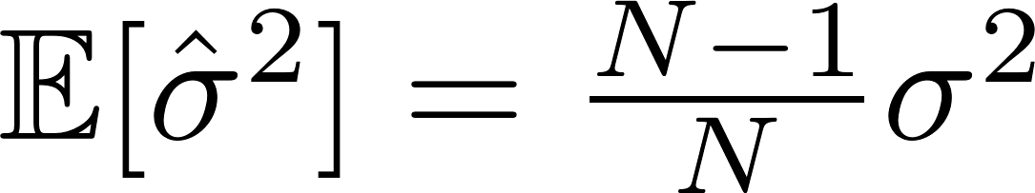

Biased estimation
Estimated mean and variance:
Ground-truth mean and variance: and
Define , then ,
is biased estimation

Slide 17

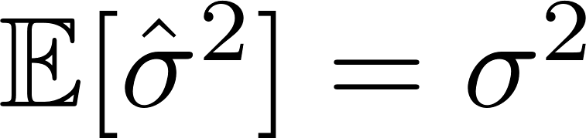
Biased estimation
is biased estimation
When ,
So the bias comes from limited sampling.

Slide 18
Data distribution assumption
Previously, we assume follow Gaussian distribution
What if follows more complicated data distribution?

Slide 19
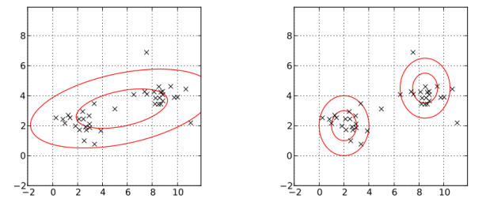
Gaussian Mixture Model
We assume follows Gaussian Mixture Model (GMM).
one Gaussian model
mixture of two Gaussian models

Slide 20
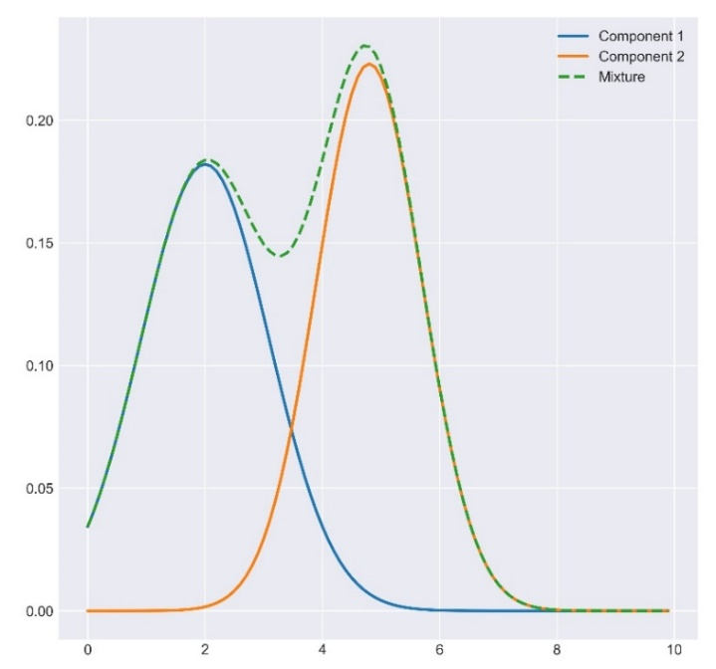
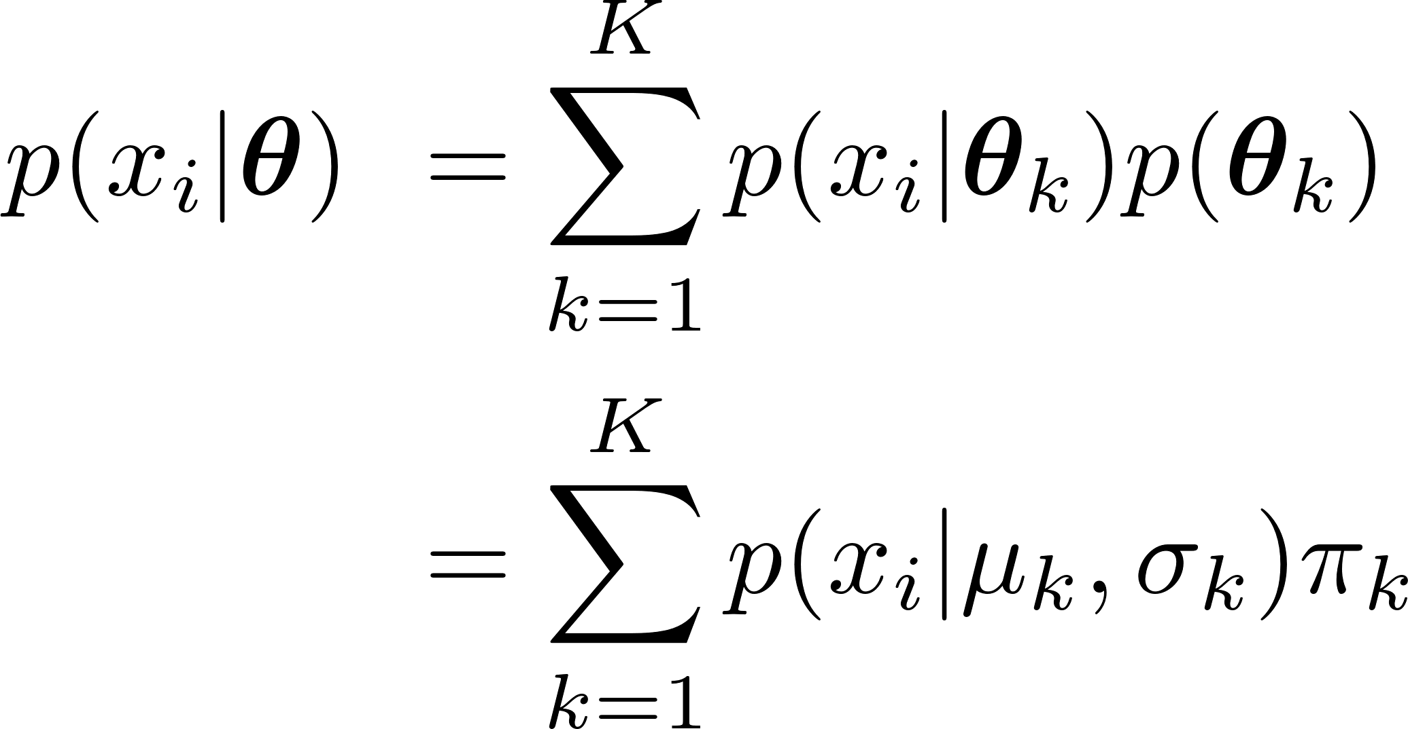
Gaussian Mixture Model
GMM parameters:
, in which

Slide 21
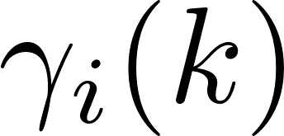


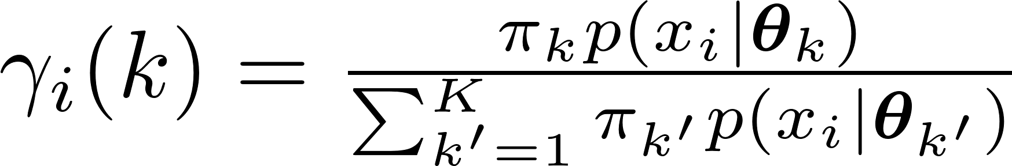
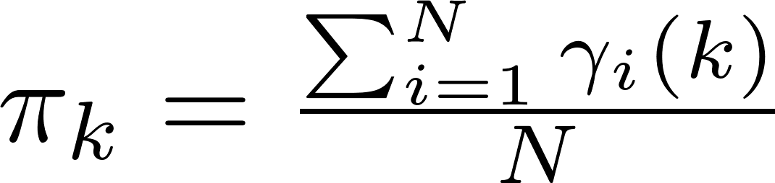
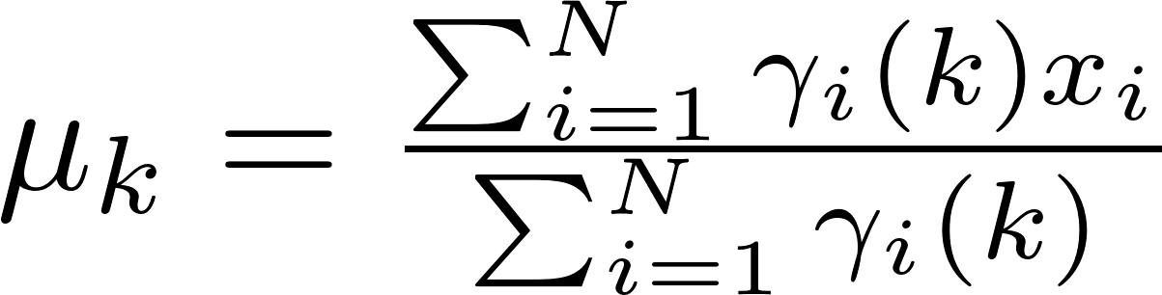
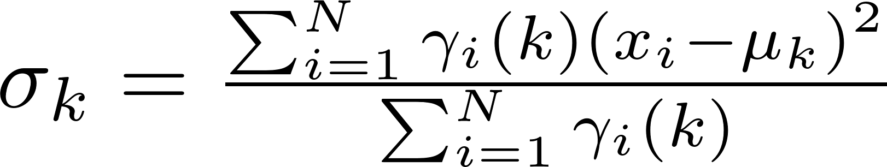
Gaussian Mixture Model
Hidden variable : the probability that the -th sample belongs to the -th Gaussian model
Due to hidden variable, we use EM algorithm to estimate
and
In each iteration:
Expectation-step: estimate the hidden variable
Maximization-step: maximum likelihood estimation

Slide 22
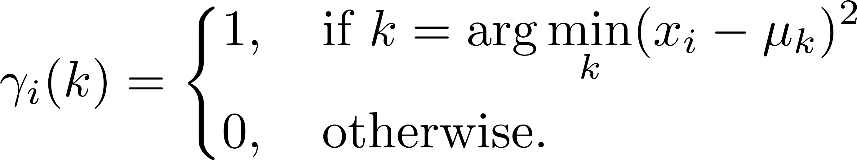
Gaussian Mixture Model and K-means
GMM is probabilistic clustering or soft clustering.
In each iteration of K-means:
Expectation-step: estimate the hidden variable
Maximization-step: maximum likelihood estimation

Slide 23
From sample to distribution
From distribution to sample
sample
distribution

Slide 24
distribution
11,8,5,5,4,5,8,8,10,9,5,3,10,6,2,8,7,4,7,9,4,8,6,9,5,6,7,6,9,7,7,7,6,7,9,6,5,3,8,8,5,8,6,7,7,8,6,5,4,6,10,6,9,8,7,4,6,6,7,9,8,10,3,7,8,8,8,7,6,9,7,3,6,9,6,5,4,5,6,9,5,7,5,6,5,9,6,8,6,8,5,6,12,8,4,8,6,4,7,13,5,10,7,7,5,7,1,9,2,4,8,7,5,8,5,4,3,7,4,6,11,3,4,10
normal distribution

Slide 25
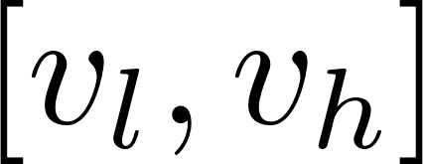
Sampling
Given a data distribution, sample data based on this distribution.
For uniform distribution in , it is easy to sample data.
But what if complicated data distribution?

Slide 26

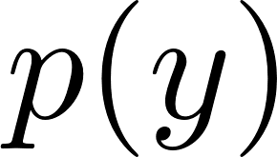
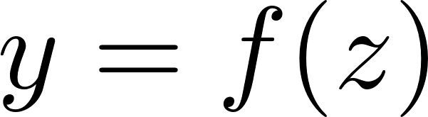
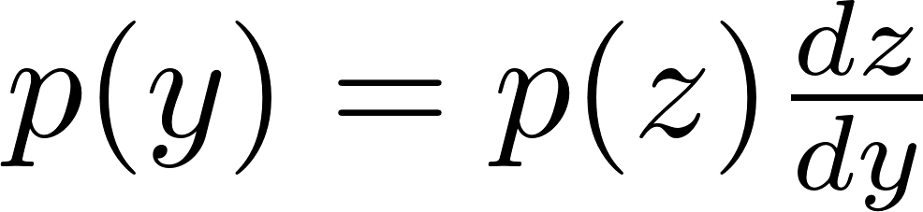
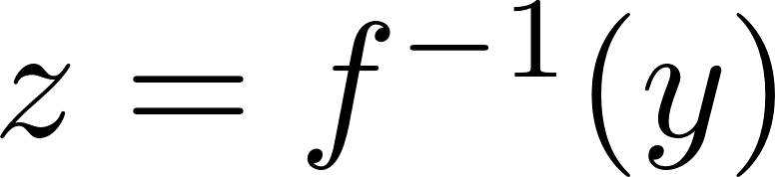
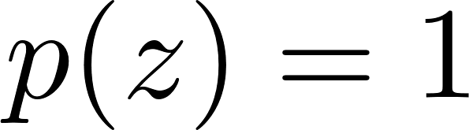
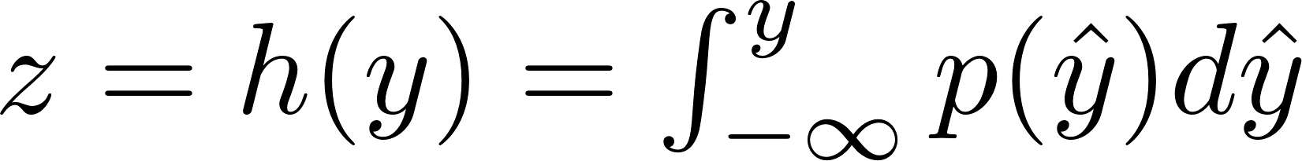
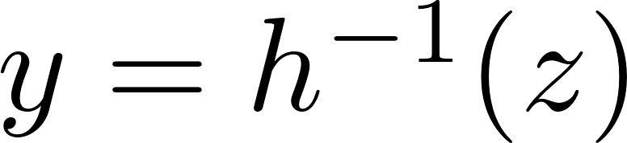

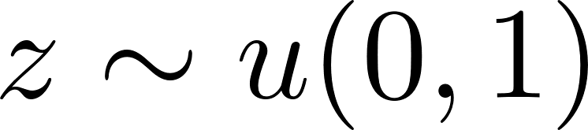
Standard distribution
Given a variable , we know , which is not easy to sample.
We assume with z uniformly distributed over the interval (0, 1)
Step 1
Step 2
We can obtain based on sampled

Slide 27
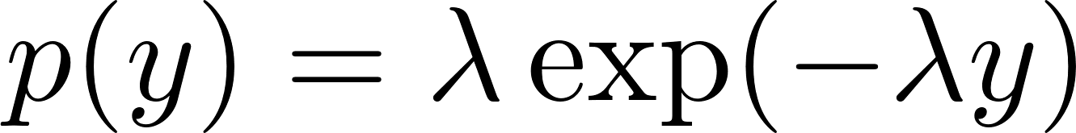
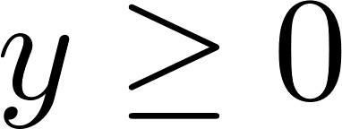
Question
Step 1
Step 2

Slide 28
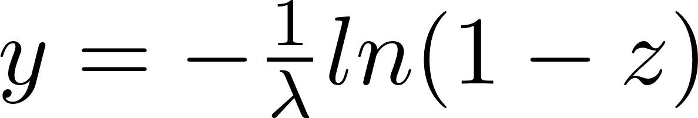
Answer
Step 1
Step 2
We can obtain based on sampled

Slide 29
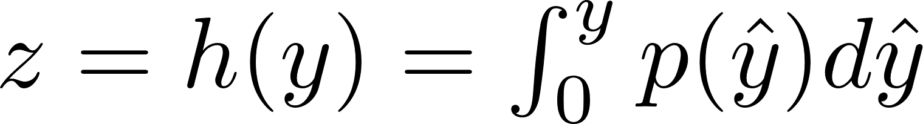
However, and may be difficult to compute.
We can reply on some “easy” (easy to sample) distributions.

Slide 30
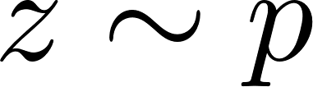
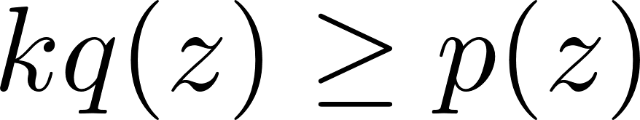









Rejection sampling
Goal: sample
Step 1: Find an envelope distribution
Step 2: sample
Step 3: accept with the ratio

Slide 31
Sometimes, an envelope distribution is not easy to find.

Slide 32




Adaptive rejection sampling
If is log concave
Find the piecewise exponential envelope distribution

Slide 33


Sometimes, we do not need sample ,
just need expectation

Slide 34




Importance sampling
weight
with
can be calculated as the weighted with

Slide 35





Markov Chain Monte Carlo (MCMC)
Goal: Draw approximate correlated samples from a target distribution p(x)
MCMC: Performs a biased random walk to explore the distribution

Slide 36
Two examples of MCMC
Metropolis–Hastings algorithm (unit-variate)
Gibbs sampling (multi-variate)

Slide 37











Metropolis–Hastings algorithm
Goal:
1. Initialize
1. Pick an initial state
2. Set
2. Iterate
1. Generate: randomly generate a candidate state according to
2. Calculate the acceptance probability
3. generate a uniform random number ,
if , , otherwise
4.
symmetric probability density function

Slide 38




Gibbs sampling
Goal:
the -th sample
Divide multiple variables into two groups:

Slide 39


Gibbs sampling
Goal:
the -th sample
1. Initialize
1. Pick an initial state
2. Set
2. Iterate
1. j = mod(t, d)
2. randomly generate according to
3.
4.

Slide 40
Thanks!

